Slide 1
Steganography in Computer Vision
Kevin Simons
Tim Brown
Amrit Kashyap

Slide 2
Steganography:
is the art and science of encoding hidden messages in such a way that no one, apart from the sender and intended recipient, suspects the existence of the message

Slide 3
Interested In:
Encode bits in images in various ways
How many bits could we reliably send?
Do you need the original image?
What is the image invariant too?

Slide 4
Naïve Solution
Read in an image and have a message you intend to encode
Change the least significant bit of each color-band on every pixel of the image
Go across the image from left to right and then from top to bottom

Slide 5
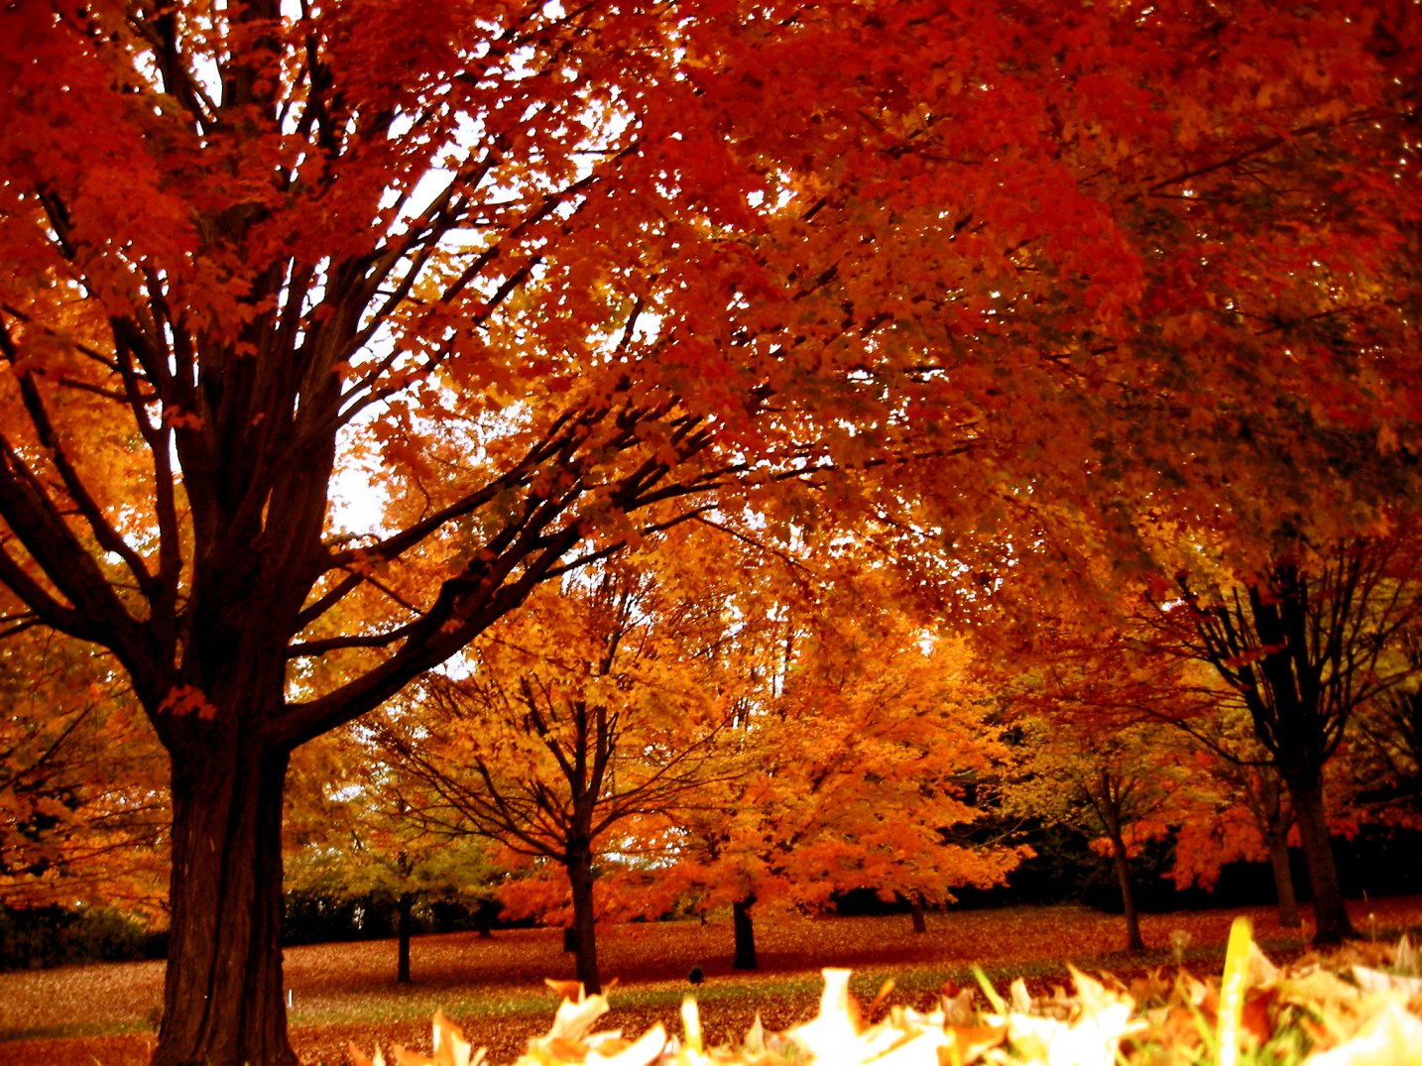

Positive Results
Can send incredible amount of bits. (Height of image) * (Width of image) * 3.
This image could encode 4,624,650 bits or 578,081 ascii characters.
Image looks unchanged to human eye and message is perfectly reconstructed:
Modified
Original

Slide 6
Negative Results
Completely lose the message if any type of compression is applied
When we saved the image as a .jpg and then attempted to read it and re-construct the message we retrieved 49.98%. Garbage. You must save as a .png or some lossless format
Is not invariant to any scaling shifts or contrast changes

Slide 7
Contrast Tiling and Blending
At certain regions of the image, simply modify the contrast a small amount
Increasing the contrast would signify a 1 and decreasing the contrast would signify a 0
After modifying the contrast we blend it back into the original image to preserver the image
Taking advantage of people’s weak contrast sensitivity

Slide 8
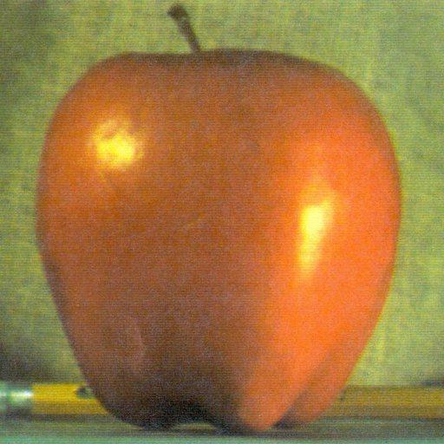

Single Example
We will read in the same image twice and on the second one we will lower contrast to signify a 0
NORMAL
DARKER

Slide 9
Blending the Images
We then create a Laplacian pyramid of each image. We also create a Gaussian pyramid with the same number of levels of the mask.
We then use the mask to create a new Laplacian pyramid that is the combination of each image.
We then collapse the pyramid to finish creating the new image

Slide 10


Mask And Recombination
Unlike the apple and orange combination, our mask puts the contrast image in the middle
There are two advantages to this. The foremost is we have 4 borders to check during the decoding process. Second the edges are unchanged with becomes important during tiling.
The masks are blurred and are opposites of each other. White indicates 100% while black indicates 0%.
Mask A
Mask B

Slide 11
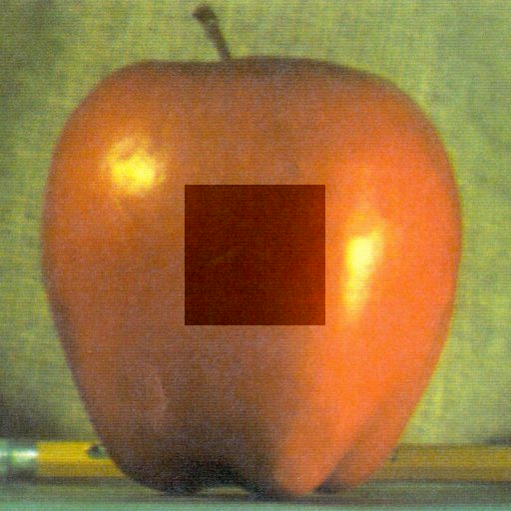
Example: No Blending, Extreme Contrast
Middle has been darkened by 70

Slide 12
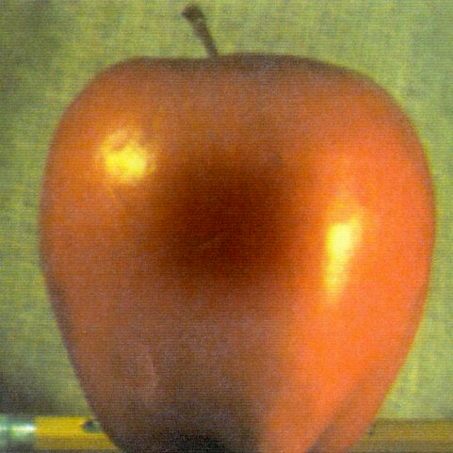
Example: Blending, Extreme Contrast
Middle has been darkened by 70

Slide 13
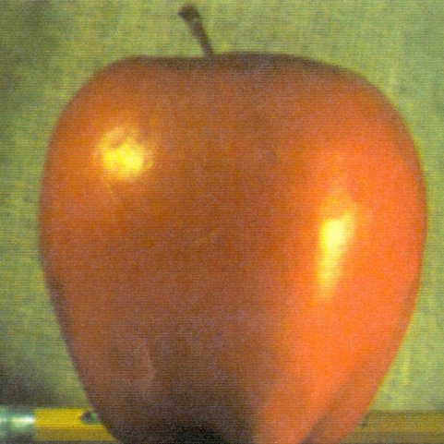
Example: Blending
Middle has been darkened by 10

Slide 14
Decoding Single Image
The recipient of the apple image (with a fixed square size) can then run a decode function which determines if the middle contrast was raised of lowered.
The contrast change is determined by looking on each side of all 4 seams and taking a derivative on the pixel intensity

Slide 15
Tiling
While the single blend looks good, you can only encode one bit of information
Instead, we will break the image into sub-images and for each image we will raise or lower the contrast of the center and then blend.
The sub-images will pieces without issue because the contrast change is in the middle

Slide 16
Hyper-Parameters
A hyper-parameter of this problem is the square size to lighten or darken.
A smaller square size will allow us to encode more information
However, smaller square sizes can be more prone to local changes in the image

Slide 17
Amount of Contrast Change
A pseudo-hyper parameter is the amount is the magnitude of the contrast we increase or decrease on the center of each sub-image
The larger the change the more confidence we have in recovering the message; however the easier it is to see
We solved both of these problems with cross validation. We would encode bits with different hype-parameters and determine the percentage that could be recovered

Slide 18
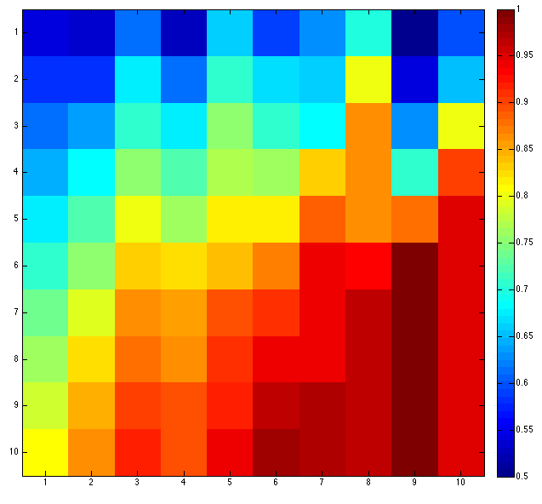
Percentage recovered with varying square size and contrast
Contrast Magnitude
Square Size (x 10)

Slide 19
Reed–Solomon Error Correction
We then calculated the number of bits our message needed based on the length of the message.
We know that a Reed-Solomon error correction code needs an additional (error percentage) * (2) * (number of bits for message)
We then a searched this cross-validation for the smallest contrast and box- size that allowed us to send enough bits with Reed-Solomon correction with the calculated percent error to guarantee the message could be recovered by the user.

Slide 20
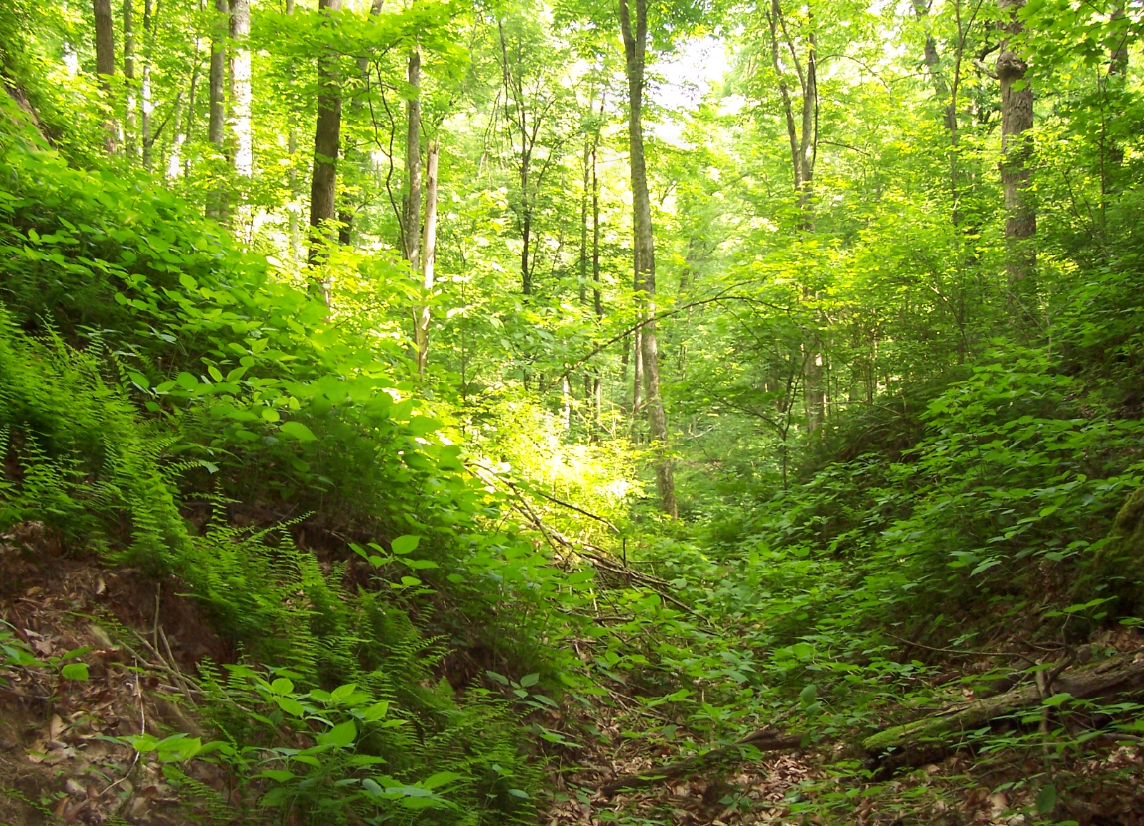
Results:
Square Size = 3, Contrast = 5, 205 bits needed. 88% correct.
This image says “Hello CS 280 Class :)”

Slide 21
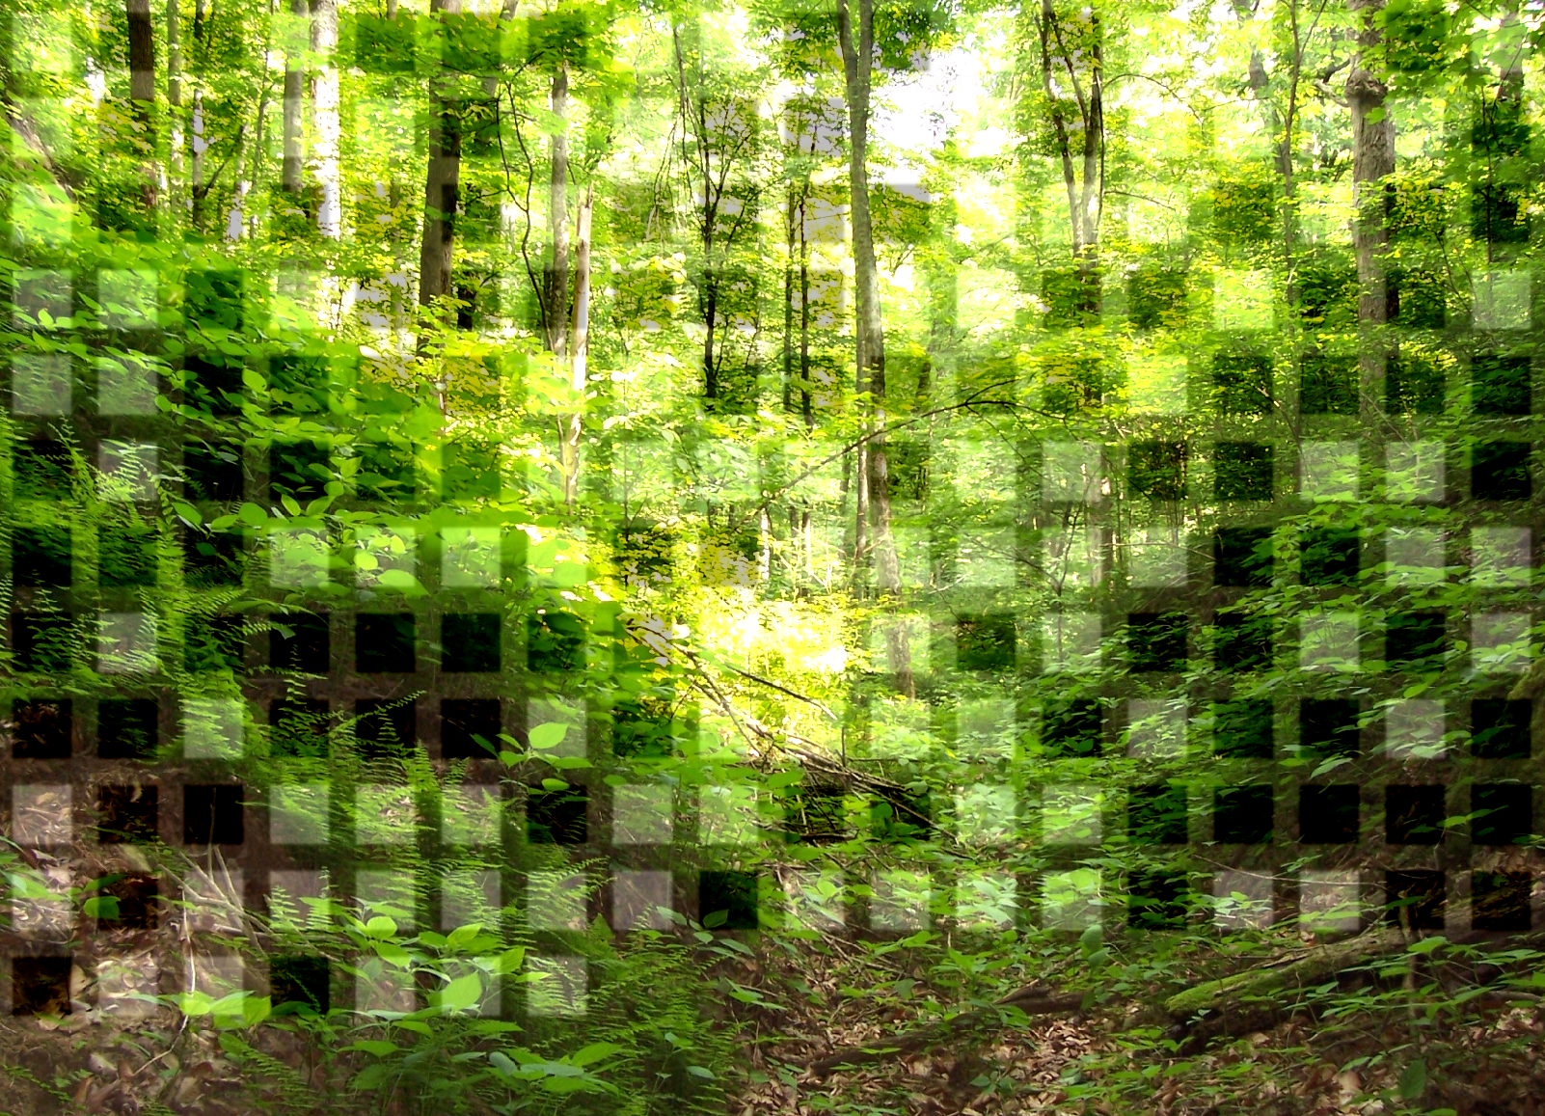
Increased Contrast Magnitude
Square Size = 3, Contrast = 65, 205 bits needed. 88% correct.
This image says “Hello CS 280 Class :)”

Slide 22
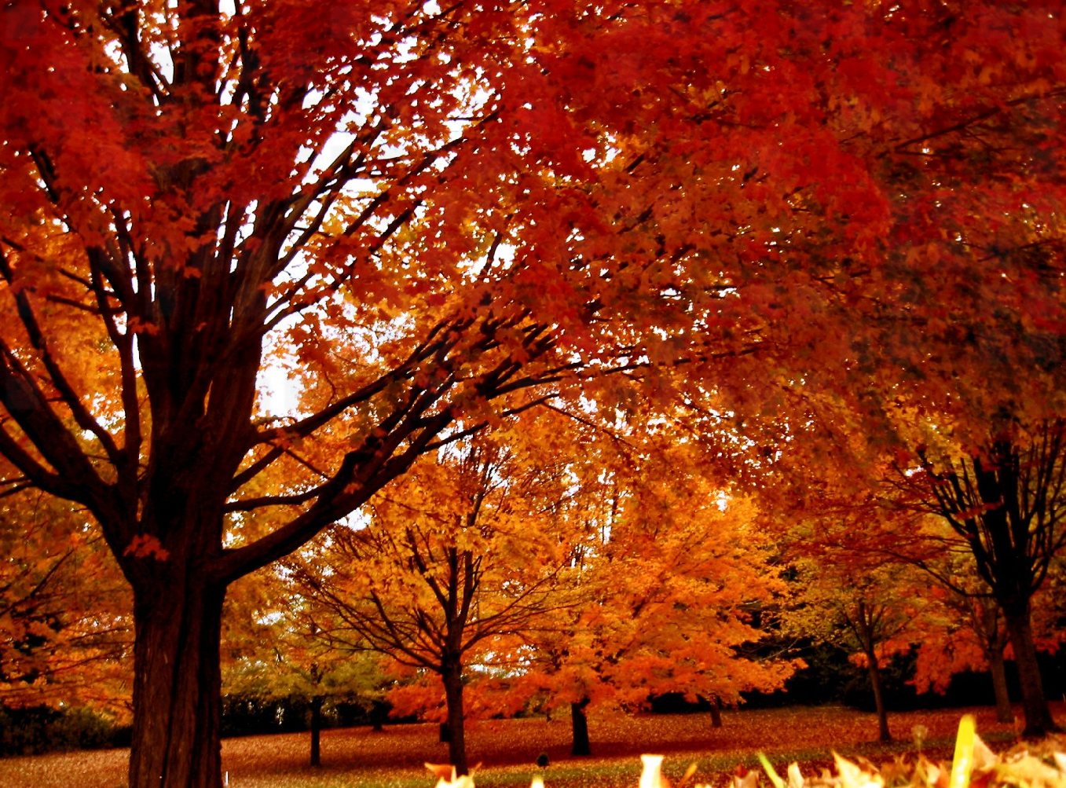
Same Message in Leaves
Square Size = 2, Contrast = 8, 202 bits needed. 84% correct.

Slide 23
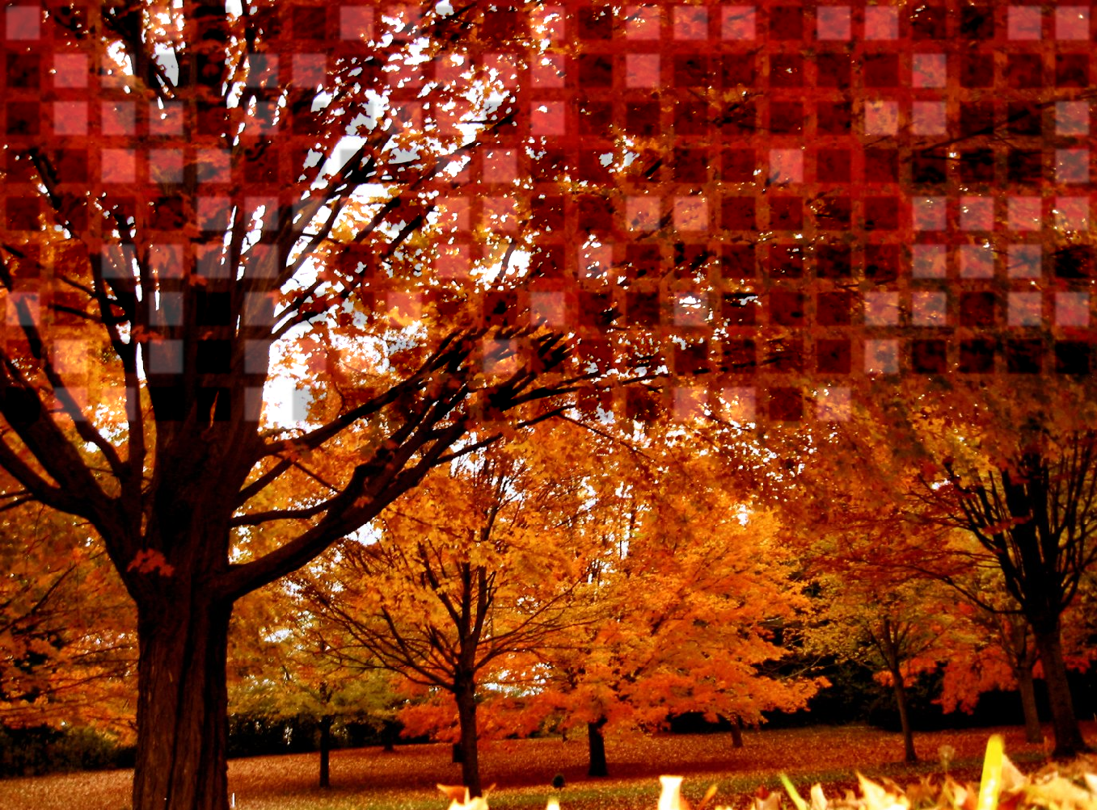
Increased Contrast Magnitude
Square Size = 2, Contrast = 56, 202 bits needed. 84% correct.

